Slide 1
Anime EDA
Skylar Peven
DSC 530
Professor Metzger
02-26-2025

Slide 2
Statistical Question
Does the production budget of a top 100 anime produce a better-quality result in terms of ratings?

Slide 3
Hypothesis
Production budget has a positive effect on anime ratings for the top 100 anime.

Slide 4
Dataset
Location: https://www.kaggle.com/datasets/samikshadalvi/100-most-watched-anime-in-the-world

Slide 5
Summary of Variables Used in Dataset
Ratings - The average user rating on a scale of 1 to 10 for each anime. This feature tells us how well the anime is received by its viewers and can indicate its overall success. Ratings may change from country to country.
Number of Episodes - The total number of episodes produced for the given anime. It helps to explore whether long-running shows are more popular compared to short series.
Budget (in Million USD) - The estimated production budget for the anime, in millions of U.S. dollars.
Release Year - The year the anime was first released or aired. This tracks when an anime was produced and whether older or newer anime dominates global popularity.
Duration per Episode (minutes) – This is the average length of each episode in minutes. This feature shows the runtime of the anime and will be used to determine if episode length affects anime popularity.

Slide 6

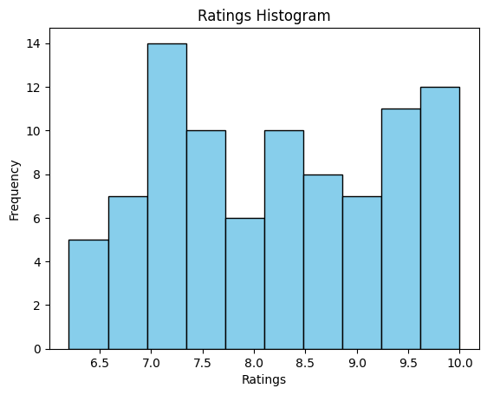
Ratings Histogram
Mean: 8.22
Mode: 9.4
Spread:
Variance: 1.24
Standard Deviation: 1.11
Tails: Slightly left skewed (-1.16*)
*Pearsons First Coefficient of Skewness

Slide 7
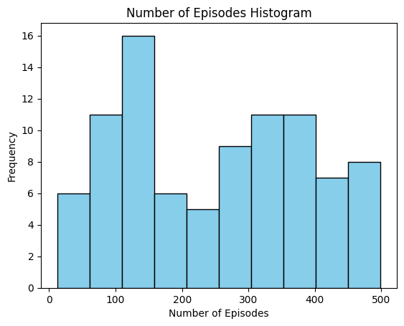
Number of Episodes Histogram
Mean: 250.72
Mode: 69
Spread:
Variance: 19057.1
Standard Deviation: 138.05
Tails: Right skewed (1.3*)
*Pearsons First Coefficient of Skewness

Slide 8
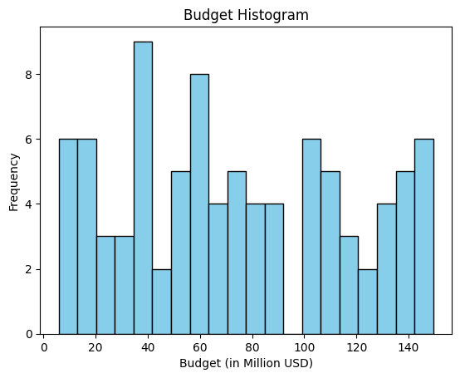
Budget Histogram
Mean: 74.26
Mode: No Mode
Median: 67.27
Spread:
Variance: 1867.02
Standard Deviation: 43.21 mins
Tails: Data is not skewed (0.49*)
*Pearsons Second Coefficient of Skewness

Slide 9
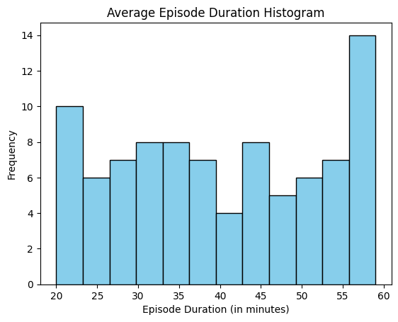
Episode Duration Histogram
Mean: 39.88
Mode: 30 and 56
Spread:
Variance: 155.40
Standard Deviation: 12.47
Tails: Data is evenly distributed (-1.29, 0.79)
*Pearsons First Coefficient of Skewness

Slide 10
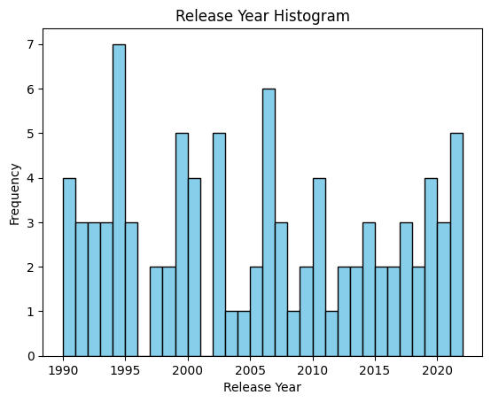
Release Year Histogram
Mean: 2005
Mode: 1994
Spread:
Variance: 99.35
Standard Deviation: 9.97
Tails: Slightly right skewed (1.11*)
*Pearsons First Coefficient of Skewness

Slide 11
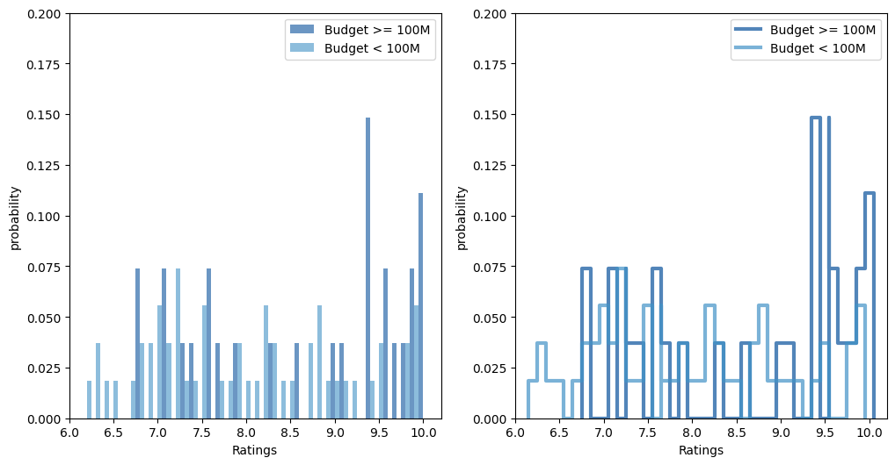

PMF Scenarios: Ratings when budget is less than 100 million and greater than 100 million

Slide 12
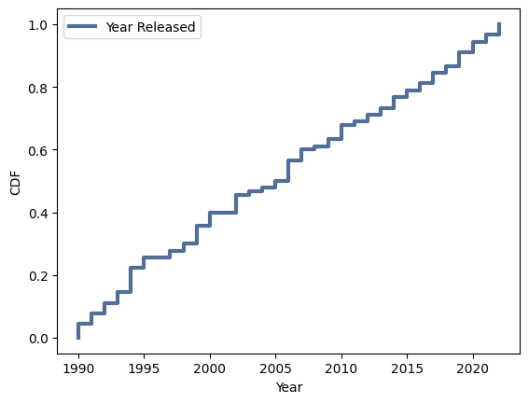
CDF of Release Year
Between and 2005 there were some short periods without a new release.
After 2005 releases became more consistent.
The plot also tells us that top 100 anime do not tend to be released in any particular years.

Slide 13
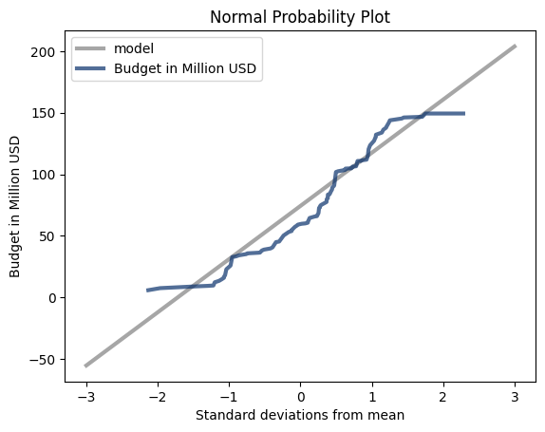
Normal Distribution – Budget variable
Analysis:
The deviations of the budget from the normal distribution indicate that the data does not follow a normal distribution. This will be good to know when trying to fit any other models.
Before tapering off at the right tail the data deviates with a high slope, indicating there are more budgets in the high range than would be expected in a normal distribution. The opposite can be said for budgets on the low end.

Slide 14
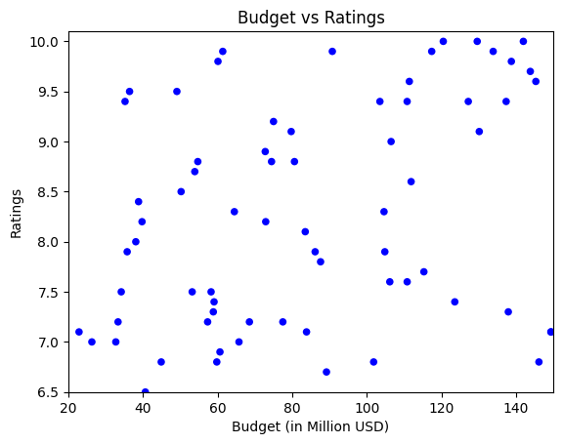
Scatter Plot: Budget VS Ratings
Analysis:
There appears to be a weak, positive correlation between budget and ratings.
I would have expected a stronger correlation to emerge from the data.
There is no obvious non-linear pattern in the scatterplot.
Covariance: 1.56
Pearson’s Correlation: 0.03
Spearman's Correlation: 0.05

Slide 15
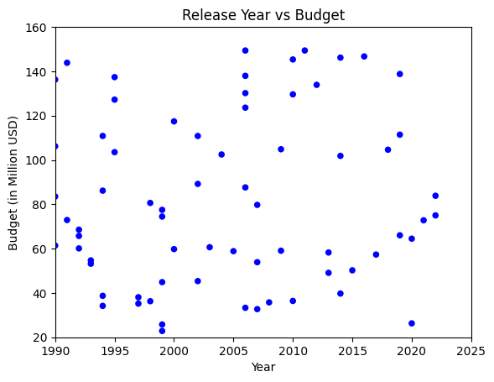
Scatter Plot: Release Year VS Budget
Analysis:
There appears to be a weak, negative relationship between the release year and budget. Both Pearson’s and Spearman's Correlation close, around (-0.07).
I would have expected at least a small positive relationship between budget and production year as studios increase their budgets to capture the growing audiences of anime.
There is no obvious non-linear pattern in the scatterplot either.
Covariance: -29.15
Pearson’s Correlation: -0.07
Spearman's Correlation: -0.06

Slide 16

Hypothesis test of correlation
H₀ = Production budget has no effect on anime ratings for the top 100 anime.
H_{a} = Production budget has an effect on anime ratings for the top 100 anime.
P-Value: 0.013
The P-value is statistically significant. Indicating the correlation between Budget and Ratings is unlikely to have occurred by chance.

Slide 17
Regression Analysis
R²: 0.054 - Approximately 5.4% of the variance in Ratings is explained by the explanatory variables in the model.
Adj. R²: -0.020 - This adjusted value suggests that the model is not be a good fit for the data.
F-statistic: 0.7308 with a p-value of 0.575 - This indicates that the overall model is not statistically significant.
Coefficients:
Intercept: 5.0302 (not significant, p = 0.876)
Budget: 0.0056 (not significant, p = 0.120)
Release_Year: 0.0015 (not significant, p = 0.927)
Ep_Len: -0.0017 (not significant, p = 0.897)
NoE: -0.0005 (not significant, p = 0.666)
Overall:
It seems like none of the predictors are statistically significant, and the model doesn't explain much of the variance in the Ratings. ☹

